Slide 1
Module 6 Guidance Notes (6.3) C++ Strings
COMP2113 Programming Technologies
ENGG1340 Computer Programming II

Slide 2
What are we going to learn?
The string class
String concatenation
String comparison
String I/O
Member functions of the string class for string manipulation, e.g., string::length() , string::empty(), string::substr(), string::find(), string::rfind(), …
You will be writing C++ programs only in Module 6.3, so make sure that your compiler option is set appropriately. We suggest to use the following command to compile your C++ program:
g++ -pedantic-errors -std=c++11 your_program.cpp

Slide 3
Recommended Readings
You may want to check out the following supplementary readings:
Book Chapters
Problem Solving with C++
Ch. 8.1-8.2
From C++ tutorials
Strings

Slide 4
The string Class
Handling C-string is rather low level, e.g., one will need to deal with the internal representation (i.e., the character array) and the null characters.
C++ standard library provides a class (i.e., programmer defined data type) named string for more convenient handling of strings.
You may think of C++ string as a wrapper/container for handling char arrays. It provides handy string operations so basically you don’t need to care about its underlying representation.

Slide 5
String Initialization
We need to include the header file <string> to use the class string:
A string object can be declared using the class name string and initialized with a C-string or another string object:
#include <string>
char a[80] = "Hello"; // a C-string
string msg1 = a; // initialized with a C-string
string msg2 = "World"; // initialized with a string literal
string msg3 = msg1; // initialized with a string object

Slide 6
String Assignment
The string class has its own end-of-string representation, for which we do not need to handle.
Unlike C-string, we can initialize or change a string object using an assignment statement after its declaration:
char a[80] = "Hello"; // C-string declaration
string msg1, msg2, msg3; // string declarations
msg1 = a; // initialized with a C-string
msg2 = "World"; // initialized with a string literal
msg3 = msg1; // initialized with a string object
Compare the above with C-string declaration on this slide

Slide 7
String – Subscript Operator
We may also access individual character using the subscript operator []:
string msg = "Hello World!";
msg[11] = '?';
cout << msg << endl;
Hello World?
Screen output

Slide 8
String Concatenation
Two strings can be concatenated to form a longer string using the binary operator +
Note that at least one of the operands of + must be a string object.
I love cats
string msg1 = "I love ";
string msg2 = "cats";
string msg3 = msg1 + msg2;
string msg4 = msg1 + "dogs";
string msg5 = "I hate " + msg2 + " and dogs";
I love dogs
I hate cats and dogs
Here, both operands are string literals (i.e., constants)
string msg = "I love " + "dinosaurs";
✗

Slide 9
String Comparison
Strings can be compared lexicographically (dictionary order) using relational (>, <, >=, <=) and equality (==, !=) operators. The comparison is carried out in a character by character manner.
Note: at least one of the operands need to be a string object
string msg1 = "Apple", msg2 = "apple";
string msg3 = "apples", msg4 = "orange";
bool c1 = msg1 == msg2;
bool c2 = msg1 < msg2;
bool c3 = msg2 < msg3;
bool c4 = msg3 != msg4;
bool c5 = msg4 > msg3;
c1
?
c2
?
c3
?
c4
?
c5
?
false
true
true
true
true

Slide 10
I/O with String Objects
Both cout and cin support string objects.
The insertion operator << and extraction operator >> work the same for string objects as for other basic data types
Note that
The extraction operator >> ignores whitespace at the beginning of input and stops reading when it encounters more whitespace
The word received by a string object will therefore have any leading and trailing whitespace deleted
Cannot read in a line or string that contains one or more blanks
string msg;
cin >> msg;
cout << msg;

Slide 11
I/O with String Objects
Example
Please input a sentence:
I love dogs
Word 1 = "I"
Word 2 = "love"
Word 3 = "dogs"
#include <iostream>
#include <string>
using namespace std;
int main()
{
string word1, word2, word3;
cout << "Please input a sentence: " << endl;
cin >> word1 >> word2 >> word3;
cout << "Word 1 = \"" << word1 << "\"\n"
<< "Word 2 = \"" << word2 << "\"\n"
<< "Word 3 = \"" << word3 << "\"\n";
return 0;
}
Screen output
Use \" for a " character in a string
string_io.cpp
How do we read in an entire line including spaces from the input then?

Slide 12
Reading a Line from Input
We use the library function getline() to read in a line from the standard input and store the line in a string:
string s;
cout << "Please input a sentence: " << endl;
getline(cin, s);
cout << "s = \"" << s << "\"\n";
string_getline.cpp
Please input a sentence:
I love dogs
s = "I love dogs"
Screen outputs

Slide 13
Reading a Line from Input
The function getline() can be used to read in a line from the current position until a delimitation character is encountered
string s;
cout << "Input 2 comma-separated phrases: " << endl;
getline(cin, s, ',');
cout << "1st phrase = \"" << s << "\"\n";
string_getline.cpp
Input 2 comma-separated phrases:
Stay hungry, stay foolish
1st phrase = "Stay hungry"
As you can see, without providing the third argument (‘,’ in this case), the default delimitation character for the getline function is the newline character ‘\n’.
Screen outputs

Slide 14
Member Functions
The class string has a number of member functions which facilitate string manipulation, which includes
string::length() – returns length of the string
string::empty() – returns whether the string is empty
string::substr() – returns a substring
string::find() – finds the first occurrence of content in the string
string::rfind() – finds the last occurrence of content in the string
string::insert() – inserts content into the string
string::erase() – erases characters from the string
string::replace() – replaces part of the string
More member functions can be found at http://www.cplusplus.com/reference/string/string, but you are expected to be get familiar with the above functions only for this course.

Slide 15
string::length()
Returns the number of characters in a string object
string s = "Stay hungry, stay foolish";
int n = s.length();
cout << "s has " << n << " characters. " << endl;
Note we use . to invoke the member function of a string object.
E.g., here s.length() means that we call the string::length() member function of the string object s.
s has 25 characters.
Screen outputs

Slide 16
Example Programs
A palindrome is a sequence of characters which reads the same forward or backward, e.g., “radar”, “level”, “kayak”, “madam”. Write a program to check if an input string is a palindrome. Hint: compare corresponding characters in the string
Write a program to reverse an input string. E.g., the reverse of "apple" is "elppa". Hint: use concatenation to construct the resulting string in reverse
palindrome.cpp
reverse_string.cpp

Slide 17
string::empty()
Returns true if a string object is empty; false otherwise
string s;
if (s.empty())
cout << "s is empty." << endl;
else
cout << "s has " << s.length() << " characters.\n";
s is empty.
What if s = " "?
Is this an empty string?
Screen outputs
No, this is a string with a space character, and its length is 1.

Slide 18
string::erase()
Erase n characters starting at a specific position pos from the current string
Note that the string will be modified
[0] | [1] | [2] | [3] | [4] | [5] | [6] | [7] | [8] | [9] | [10] | [11] | [12] | [13] | [14] | [15] | [16] | [17] | [18] | [19] | [20] | [21] | [22] | [23] | [24]
S | t | a | y |  | h | u | n | g | r | y | , |  | s | t | a | y |  | f | o | o | l | i | s | h
text
text.erase(11, 6)
Resulting string: "Stay hungry foolish"
pos
n

Slide 19
Example
string firstName = "Alan";
string name = firstName + " Turing";
string str1 = "It is sunny. ";
string str2 = "";
string str3 = "C++ programming.";
string str4 = firstName + " is taking " + str3;
cout << str1.empty() << endl;
cout << str2.empty() << endl;
str3.erase(11,4);
cout << str3 << endl;
cout << firstName.length() << endl;
cout << name.length() << endl;
cout << str4 << endl;
0
1
C++ program.
4
11
Alan is taking C++ programming.
string_op.cpp
Screen outputs

Slide 20
string::substr()
Returns a substring of the current string object starting at the character position pos and having a length of n characters
[0] | [1] | [2] | [3] | [4] | [5] | [6] | [7] | [8] | [9] | [10] | [11] | [12] | [13] | [14] | [15] | [16] | [17] | [18] | [19] | [20] | [21] | [22] | [23] | [24]
S | t | a | y |  | h | u | n | g | r | y | , |  | s | t | a | y |  | f | o | o | l | i | s | h
text
text.substr(0, 11)
text.substr(18)
pos
n
The second parameter is omitted, this extracts a substring till the end of string.

Slide 21
string::substr()
Example
string s;
string str;
s = "It is cloudy and warm.";
cout << s.substr(0, 5) << endl;
cout << s.substr(6, 6) << endl;
cout << s.substr(6, 16) << endl;
cout << s.substr(17, 10) << endl;
cout << s.substr(3, 6) << endl;
str = s.substr(0, 8);
cout << str << endl;
str = s.substr(2, 10);
cout << str << endl;
Screen outputs
It is
cloudy
cloudy and warm.
warm.
is clo
It is cl
is cloudy
substring.cpp

Slide 22
string::find()
Searches a string object for a given string str, and returns the position of the first occurrence
When pos is specified the search only includes characters at or after position pos, ignoring any possible occurrences in previous locations
If there is no occurrence of str, the constant value string::npos (i.e., –1) will be returned
find(str)
find(str, pos)

Slide 23
string::find()
This example shows that the search is case-sensitive
Example
string s = "Outside it is cloudy and warm.";
string t = "cloudy";
cout << s.find("is") << endl;
cout << s.find('s') << endl;
cout << s.find(t) << endl;
cout << s.find('i', 6) << endl;
cout << s.find('o') << endl;
if (s.find("the") == -1)
cout << "not found" << endl;
if (s.find("the") == string::npos)
cout << "not found" << endl;
Screen outputs
11
3
14
8
16
not found
not found
string_find.cpp

Slide 24
string::rfind()
Searches the current string object for the content specified in str, and returns the position of the last occurrence
When pos is specified the search only includes characters at or before position pos, ignoring any possible occurrences in later locations
If there is no occurrence of str, the constant value string::npos (i.e., –1) will be returned
rfind(str)
This is essentially to search in the reverse direction from the end of the string
rfind(str, pos)

Slide 25
string::rfind()
Example
string s = "Outside it is cloudy and warm.";
string t = "cloudy";
cout << s.rfind("is") << endl;
cout << s.rfind('s') << endl;
cout << s.rfind(t) << endl;
cout << s.rfind('i', 6) << endl;
cout << s.rfind('o') << endl;
if (s.rfind("the") == -1)
cout << "not found" << endl;
if (s.rfind("the") == string::npos)
cout << "not found" << endl;
Screen outputs
11
12
14
4
16
not found
not found
string_rfind.cpp

Slide 26
string::insert()
Inserts the content specified in str at position pos of the current string
[0] | [1] | [2] | [3] | [4] | [5] | [6] | [7] | [8] | [9] | [10]
S | t | a | y |  | h | u | n | g | r | y
text
v | e | r | y
text.insert(5, "very ")
pos
str
Resulting string: "Stay very hungry"

Slide 27
string::replace()
Replaces n characters starting at position pos from the current string by the content specified in str
[0] | [1] | [2] | [3] | [4] | [5] | [6] | [7] | [8] | [9] | [10]
S | t | a | y |  | h | u | n | g | r | y
text
f | u | n | n
text.replace(5, 5, "funn")
pos
n
str
Resulting string: "Stay funny"

Slide 28
Example
string s1 = "Cloudy and warm.";
string s2 = "Angel is taking programming.";
string t1 = " very";
string t2 = "Nelson";
cout << s1.insert(10, t1) << endl;
cout << s2.replace(0, 5, t2) << endl;
Cloudy and very warm.
Nelson is taking programming.
string_insert_replace.cpp
Screen outputs

Slide 29
Programming Problems

Slide 30
Programming Problems 1-3
Write a program that finds the positions of ALL occurrences of a substring in a string, starting from the first occurrence to the last occurrence.
Write a program that finds the positions of ALL occurrences of a substring in a string, starting from the last occurrence to the first occurrence.
Modify the program “palindrome.cpp” on this slide so the input text may contain spaces and also uppercase/lowercase letters. For example, “Was it a car or a cat I saw” should be considered a palindrome.
064001
064002
064003

Slide 31
Programming Problem 4
064004
Write a program that determines the length of a string by using for loop. DO NOT use any functions provided by <string>.

Slide 32
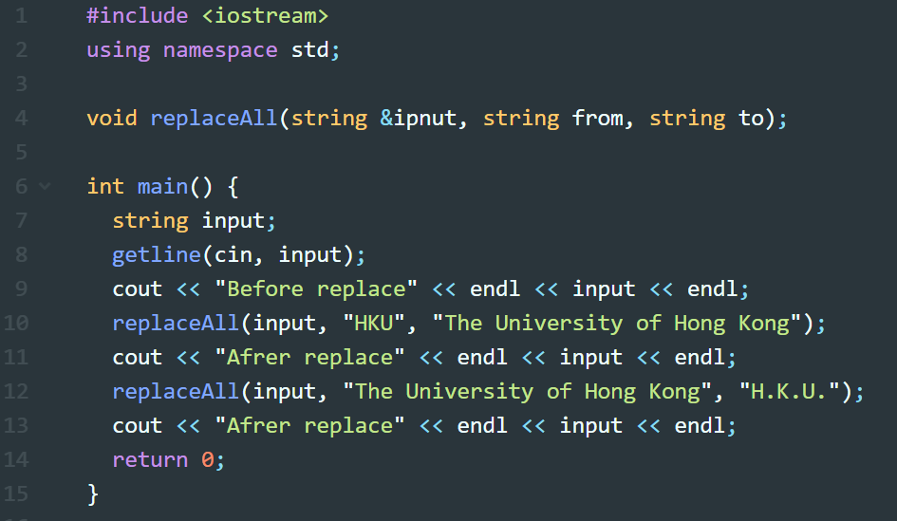
Programming Problem 5
064005
Your task is to implement the replaceAll function so that it will update the string input by replacing all occurrences of from by the string in to. Here is a sample input (in blu) and output of the program:
I study at HKU; I love HKU!
Before replace:
I study at HKU; I love HKU!
After replace:
I study at The University of Hong Kong; I love The University of Hong Kong!
After replace:
I study at H.K.U.; I love H.K.U.!

Slide 33
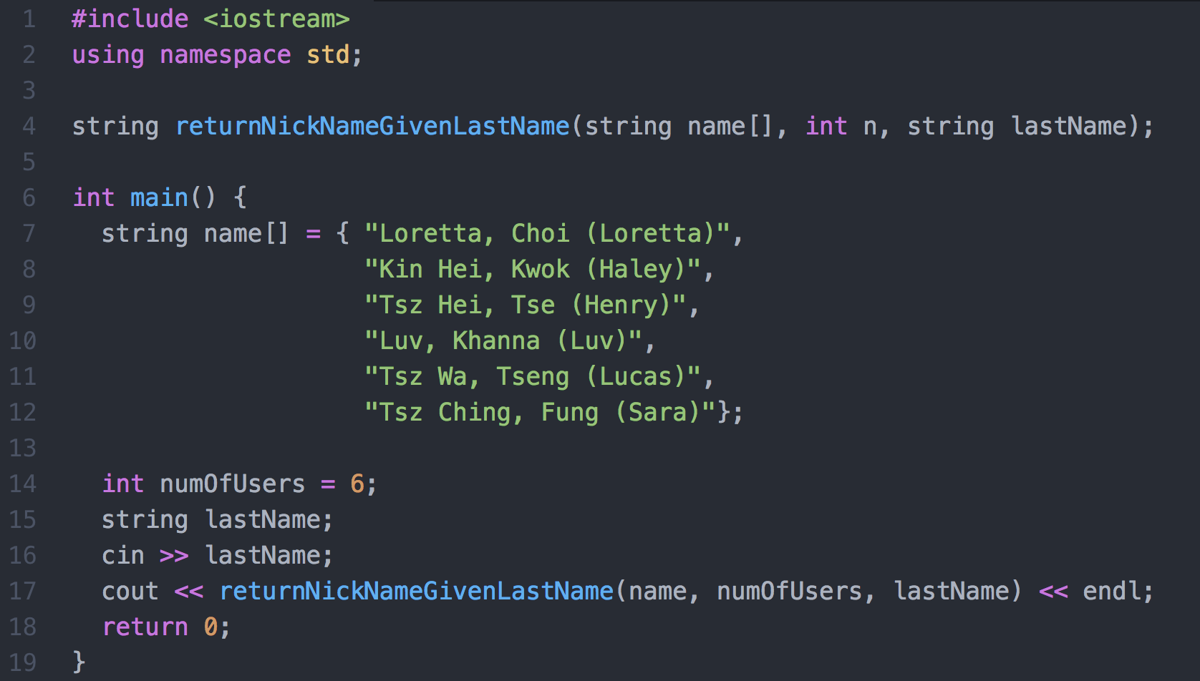
Programming Problem 6
064006
Consider the following program:

Slide 34
Programming Problem 6 (cont’d)
064006
The function returnNickNameGivenLastName will search in the string array name for the string lastName of a user and returns the nickname of the matched user.
Each slot of the name[] array stores the name of a user. It uses the following format: [First name][comma][space][Last name][space][open bracket][Nickname][close bracket]
Note that the second input parameter of the function is an integer denoting the number of users (i.e., number of slots in the name[] array).
The function returns a string, which is the nickname of the matched user (you may assume that there is at most one match).
The function returns the string "Not found!" if no match is found. Here is a sample input (underlined) and output of the program:
Choi Loretta

Slide 35
The Hangman Game
Tutorial Problem - Strings

Slide 36
The Hangman Game
You are going to implement the Hangman game in this task.
Your program will generate a random word for a user to guess.
You program should display dashes for unrevealed letters for the word
The player will guess a letter in each round
If the letter appears in the word, display all occurrences of the letter in the word
Otherwise add one stroke to the hangman picture
The game ends when
Either the player wins by successfully guessing the complete word
Or the player loses when the hangman picture is shown in full

Slide 37
The Hangman Game
Sample game play (suppose the word is “engineering”):
Word: -----------
|
Guess a letter: a
Word: -----------
|
O
Guess a letter: e
Word: e----ee----
|
O
Guess a letter: o
Word: e----ee----
|
O
|
Guess a letter: i
Word: e--i-ee-i--
|
O
|
Guess a letter: u
Word: e--i-ee-i--
|
O
/|
Guess a letter: s
Word: e--i-ee-i--
|
O
/|\
Guess a letter: t
Word: e--i-ee-i--
|
O
/|\
/
Guess a letter: g

Slide 38
The Hangman Game
Sample game play (suppose the word is “engineering”):
Word: e-gi-ee-i-g
|
O
/|\
/
Guess a letter: n
Word: enginee-ing
|
O
/|\
/
Guess a letter: r
Word: engineering
|
O
/|\
/
You win!
winning case
Word: enginee-ing
|
O
/|\
/
Guess a letter: b
Word: engineering
|
O
/|\
/ \
You lose!
losing case
hangman.cpp provides the completed version of this tutorial problem. You may compile and run it to see the expected results first.

Slide 39
Task 1: Generate a random word
Open hangman_incomplete.cpp.
The word list to be guessed by the player is stored in an array of strings:
Generate a random number to randomly select one of the words in the word list as the guessing word.
string wordlist[10] = { "engineering", "hangman", "brainstorm", "random",
"envelope", "interface", "iceberg", "humour", "lemon", "commander"};
// TODO: Task 1: fill in the index to choose a random word from the word list
string word = wordlist[ ];
Complete this in the main() function
Store the guessing word

Slide 40
Task 2: Initialize the answer
Next, we need to initialize the answer string so that it contains only the hyphen '-' character to hide all letters of the guessing word. E.g., if the guessing word is "random", the answer is initialized to "------".
Task 2 is to complete the function init_answer():
// return a string containing a sequence of '-' with specified length
string init_answer( int length )
{
string g;
// TODO: Task 2: compose the string g so that its length = length and
// it only contains the letter '-'
return g;
}
Complete the task here. Idea: Append the letter '-' to g until g is of the required length

Slide 41
Task 3: Call init_answer()
In the main function, we will need to call init_answer() and store the resulting string in the variable answer.
// initialize the answer string
// TODO: Task 3: call init_answer and assign it to answer
string answer =
Complete this by calling the function init_answer().
What is the parameter that needs to be passed? What should be the length of the string answer?

Slide 42
Game Logic
Now take a look at the while loop in the main() function.
The game logic is as follows:
While the game is not ended
Show the current answer and the hangman figure
Determine whether it is end of game. There are two ways to end a game:
the player guessed the word. In this case, all the letters in the string answer should be revealed.
the player loses because he made too many wrong guesses.
If it is the end of game, print the appropriate message and quit
Otherwise, ask the user to make a guess.
If the guess is correct, update the answer by unmasking the correct letters
Otherwise, update the counter for recording the number of wrong guesses

Slide 43
Task 4: Game Logic
Let's complete the game logic in the main function().
while (!endgame)
{
cout << "Word: " << answer << endl;
show_hangman( num_wrong_guess );
// determine if it's an end game
// TODO: Task 4: fill in the end-of-game conditions
if ( )
{
cout << "You win!" << endl;
endgame = true;
}
else if ( )
{
cout << "You lose!" << endl;
endgame = true;
}
else {
…
}
}
Fill in the end-of-game conditions here

Slide 44
After guessing a letter
After the player has guessed a letter, we need to check if the letter is in the guessing word.
while (!endgame)
{
…
else {
cout << "Guess a letter: ";
cin >> guess;
if ( isGuessInWord( word, guess) )
update_answer( word, answer, guess );
else
num_wrong_guess++;
}
}
This part in the main() function is done for you already.
Check whether the letter input by the player is in the guessing word
If yes, update the current answer to unmask the letter
e.g., if word is "apple", the answer before the guess is "-----" and the player inputs the letter 'p', then answer would become "-pp--"

Slide 45
Task 5: Check if a letter is in a word
Complete the function isGuessInWord() which checks if a letter appears in a word
// return if the letter c appears in the string w
bool isGuessInWord( string w, char c)
{
// TODO: Task 5: complete the function return a boolean value
// to indicate whether c appears in w
}
Complete the function here.
CHALLENGE: Can you do this by using only one statement?

Slide 46
Task 6: Unmask the correct letter
If the player guesses a letter correctly, we will need to unmask it in the string answer. This is done in the function update_answer().
// assume that w and ans are of the same length
// copy all occurrences of letter c in string w to the corresponding
// positions in string ans
// e.g. string w = "xyzxyz"
// and string ans = "------", char c = 'y'
// then ans will become "-y--y-"
void update_answer( string w, string & ans, char c)
{
// TODO: Task 6
}
Note that ans is passed by reference, which means that any modification to ans will be reflected to the corresponding actual parameter passed to this function
Complete the function here.
Idea: Go through the letters in w one by one, and whenever the letter c is found, update the corresponding position in ans

Slide 47
Task 7: Display the hangman figure
// show the hangman diagram
// state is the number of wrong guess
void show_hangman( int state )
{
// first line
cout << " |" << endl;
// second line
if (state >= 1)
cout << " O" << endl;
else
cout << endl;
// TODO: Task 7: Complete displaying the 3rd and 4th lines
// of the hangman figure
// third line
// fourth line
}
Finally, complete the show_hangman() function which draws the hangman figure depending on how many times the player has made a wrong guess.
Complete these two parts to draw the 3rd and 4th lines of the hangman figure.
Note that you need to write '\\' to output the character '\'
You should be able to play
the hangman game now!

